Slide 1
The (3) Branches of government
Legislative, Executive, Judicial

Slide 2
The PreaMBLE
We the people of the United States, in order to form a more perfect union, establish Justice, ensure domestic Tranquility, provide for the common defense, promote the general Welfare, and secure the Blessings of Liberty to ourselves and our Posterity, do ordain and establish this Constitution for the United States of America.

Slide 3
WHAT IS THE PURPOSE OF GOVERNMENT?
Government is derived by the people to protect their inalienable rights to life, liberty, and property.
The government is responsible for making sure that our rights and welfare are protected.

Slide 4
LEVELS OF GOVERNMENT
Local - The governing body of a town or district; the administration of civic affairs of a city, town, or district by its residents rather than by the state.
State – The government of a specific state within the U.S.
Central / National – Concerned with the affairs that affect the entire nation, such as defense, international relations, taxation, and trade.

Slide 5
Constitution
A Constitution:
Is a basic plan of government
Defines the parts of Government, Duties, & Powers
Gives rights to citizens
Makes government legitimate (legal)
LIMITS THE POWER OF GOVERNMENT

Slide 6
U.S. Constitution
The Highest Law of the Land - 1787
Federalism – U.S. keeps some power, the states are granted others
Separates Government into (3) Branches
Bill of Rights – 1st Ten Amendments
Freedom of Speech, Religion, etc.

Slide 7
LEGISLATIVE BRANCH
Article One
Known As: Congress
Meets In: The Capitol (Austin/D.C.)
Duty: Makes Laws
Bicameral – (2) Chambers
House of Representatives & Senate
Divide work among committees
Senate – (2) from each state, 6 year terms

Slide 8
LEGISLATIVE BRANCH
Makes laws to:
Lay and collect taxes
Pay the debts
Provide for the common defense and general welfare of the United States
Regulate interstate and foreign commerce
Declare War

Slide 9
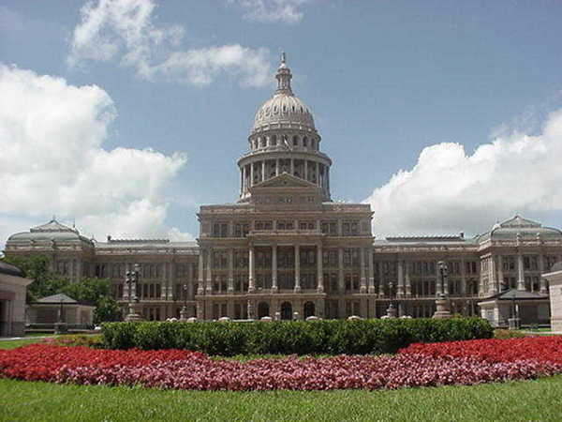
Texas capitol building

Slide 10
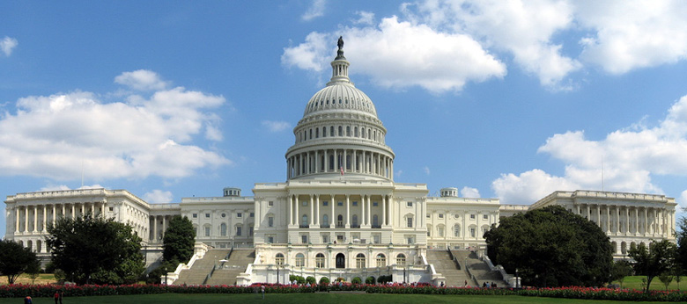
u.s. capitol building

Slide 11
TX Speaker of the house
Joe Straus (R)

Slide 12
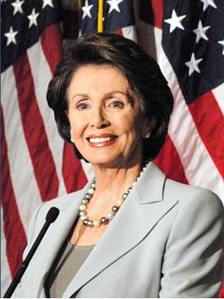
U.S. Speaker of the house
Nancy Pelosi (D)

Slide 13
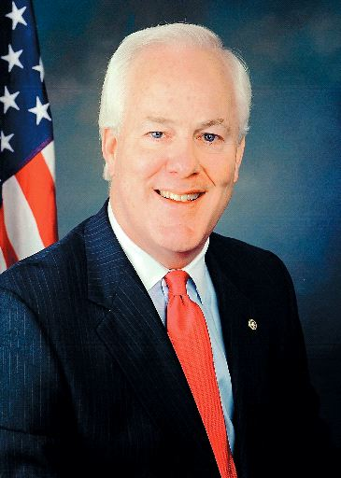
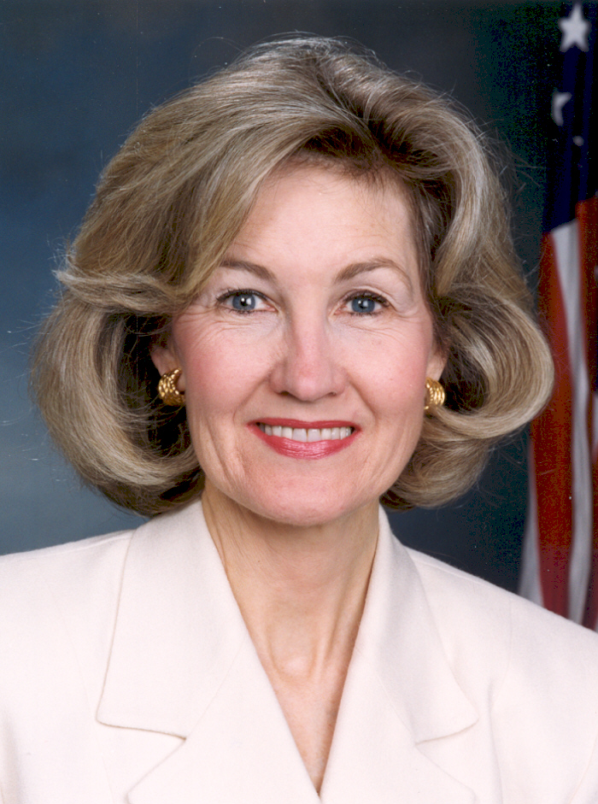
Texas senators
John Cornyn (R)
Kay Bailey Hutchinson (R)

Slide 14
Executive branch
Article II
Known As: The President
Lives at: White House
Duty: Carry/execute out the laws
Serve four year terms
Powers include: veto, pardon, martial law
Can serve up (2) consecutive four-year terms

Slide 15
Executive branch
The President Is:
Commander-in-Chief of the Armed Forces
Appoints:
Judges
Ambassadors
Other officials
Makes Treaties

Slide 16
Governor perry

Slide 17
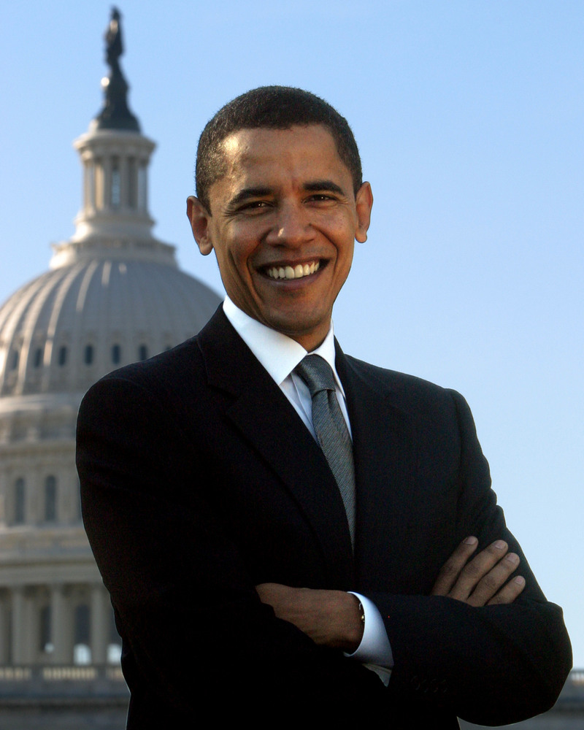
President obama

Slide 18
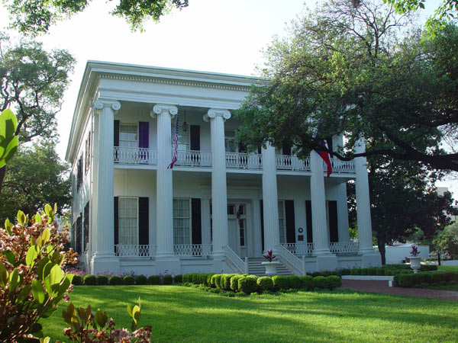
The governors mansion

Slide 19
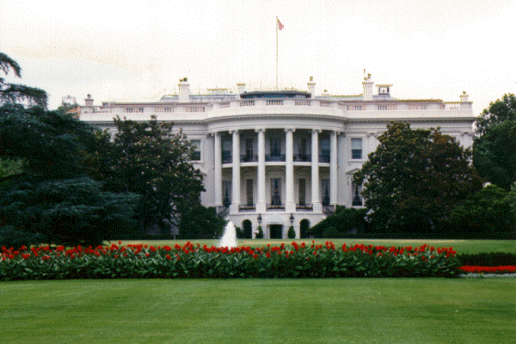
The white house

Slide 20
Judicial branch
Known As: The Supreme Court
Meets At: The Supreme Court Building
Duty: Interprets Laws, the Constitution, and Treaties
There are (9) Justices
U.S. justices are appointed by the President and serve for life (or until they retire)
High court of appeals (not criminal court)
Current Chief Justice: John Roberts, Jr.

Slide 21
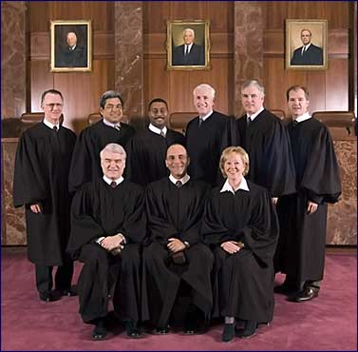
Texas Supreme court

Slide 22
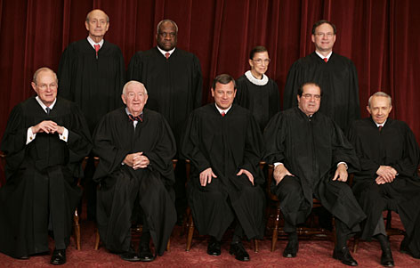
u.s. Supreme court justices

Slide 23
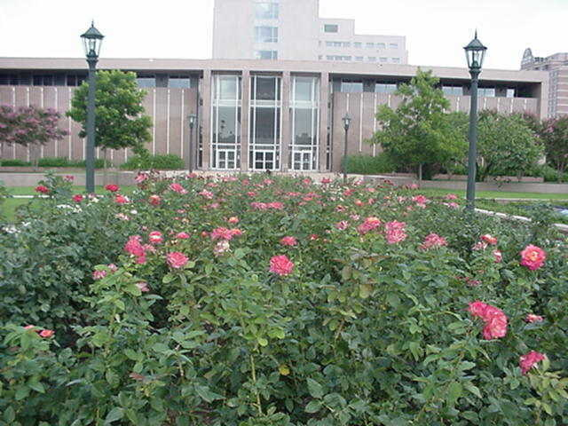
TX Supreme court building

Slide 24
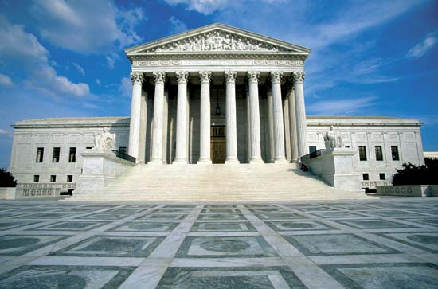
U.S. Supreme court building

Slide 25
Checks & balances
Each of the three branches of government has the power to check the other two. In theory, this keeps any branch from assuming too much power.
The balance of power between the three branches provides for a strong national (federal) government that still has systems in place that prevent it from becoming “all powerful” or tyrannical.
“A legislative, an executive, and a judicial power comprehend the whole of what it meant and understood by government. It is by balancing each of these powers against the other two that the efforts of human nature towards tyranny alone can be checked” – John Adams

Slide 26
Checks & balances
How does the Executive Branch check the Legislative Branch?
Propose Laws & Veto Laws
Makes Treaties & Appointments
Call special sessions of Congress
How does the Executive Branch check the Judicial Branch?
Appoints Federal judges
Can grant pardons to federal offenders

Slide 27
Checks & balances
How does the Legislative Branch check the Executive Branch?
Override Vetos with a 2/3 vote of both houses
Confirm Executive Appointments & Ratifies Treaties
Impeach/Remove President
How does the Legislative Branch check the Judicial Branch?
Impeach/Remove Justices
Approves Appointments
Propose amendments to override Judicial decisions

Slide 28
Checks & balances
How does the Judicial Branch check the Executive Branch?
Can declare Executive actions unconstitutional
How does the Judicial Branch check the Legislative Branch?
Can declare acts of Congress unconstitutional

