Slide 1
The Civil War
Role of African Americans
Civil War Technology & Medicine
Political Cartoons of the War

Slide 2
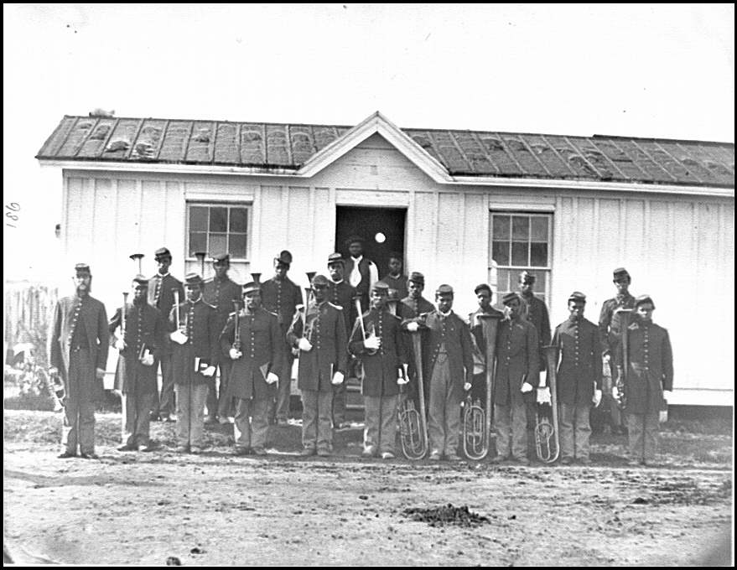
Role of African Americans
Thousands of free blacks volunteered at the start of the war but federal law forbid them to serve as soldiers.
1862 – Congress repeals the law and both free blacks and slaves enlist in the Union Army

Slide 3
Role of African Americans
Assigned to all black units commanded by white officers
Non-combat duties such as:
Building roads
Guarding Supplies
Paid half of the pay of white soldiers
1864 – Congress decides they will receive equal pay

Slide 4
54th Massachusetts Regiment
Accepted African Americans from across the North
Frederick Douglass helped recruit troops
Including two of his sons
Led an attack on Fort Wagner (South Carolina)
Nearly half the regiment is killed
Their courage helped win respect for African American soldiers
Sgt. William Carney is the first African American to win the Medal of Honor

Slide 5
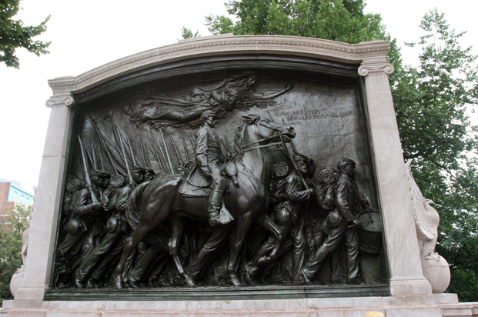
54th Massachusetts Regiment

Slide 6
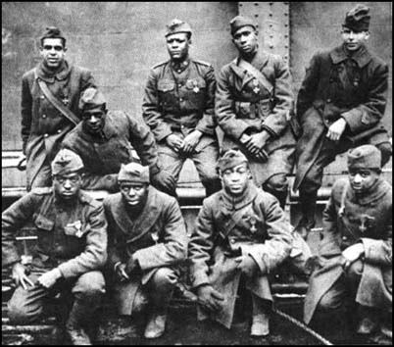
54th Massachusetts Regiment

Slide 7
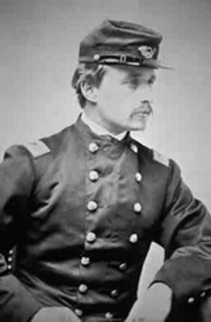
54th Massachusetts Regiment

Slide 8
African Americans in the South
Still worked in the South as slaves
Some slowed down their work/refused to work after they received word of the Emancipation Proclamation
By the end of the war, nearly 25% of the south’s slaves had escaped to freedom

Slide 9
Hard Life of Soldiers
Most were under 21 (South – 17)
Marched for LONG hours (days)
Slept on the ground in rain and snow
New technology
Cone shaped bullets made rifles 2x’s accurate
In most battles, 25% or more of the soldiers were killed or wounded

Slide 10
Medical Issues
Medical care was CRUDE
Many amputations
Poor sanitary conditions
Minor wounds often became infected
Nothing was known about germs or how wounds became infected
Pneumonia and malaria killed more than guns or cannons did
Disease/Starvation (especially for POW’s)

Slide 11
"In the operating tent, the amputation of a very bad looking leg was witnessed. The surgeons had been laboring since the battle to save the leg, but it was impossible. The patient, a delicate looking man, was put under the influence of chloroform, and the amputation was performed with great skill by a surgeon who appeared to be quite accustomed to the use of his instruments. After the arteries were tied, the amputator scraped the end and edge of the bone until they were quite smooth. While the scraping was going on, an attendant asked: 'How do you feel, Thompson?' 'Awful!' was the distinct and emphatic reply. This answer was returned, although the man was far more sensible of the effects of the chloroform than he was of the amputation."

Slide 12
Technology & Medicine
Open the “Adventure Tales” books to page 307.
In your groups, discuss each of the categories. In your spiral, copy the chart and give two reasons for each of the following in each category.
Why the Civil War would have led to improvements in this area.
How the improvements made affected the war and its outcome.

Slide 13
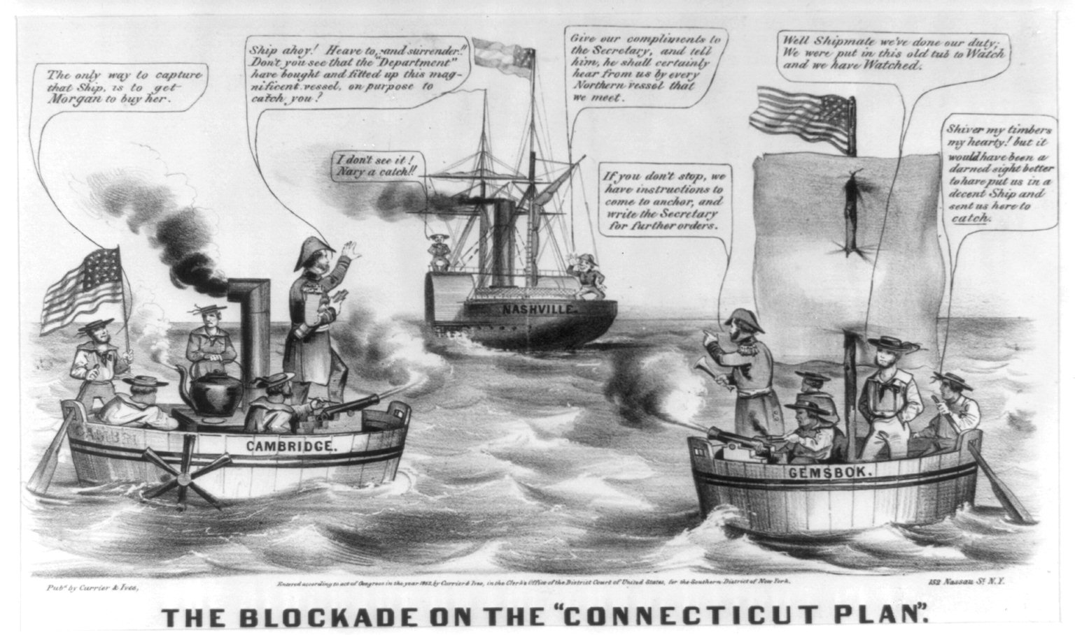

Slide 14
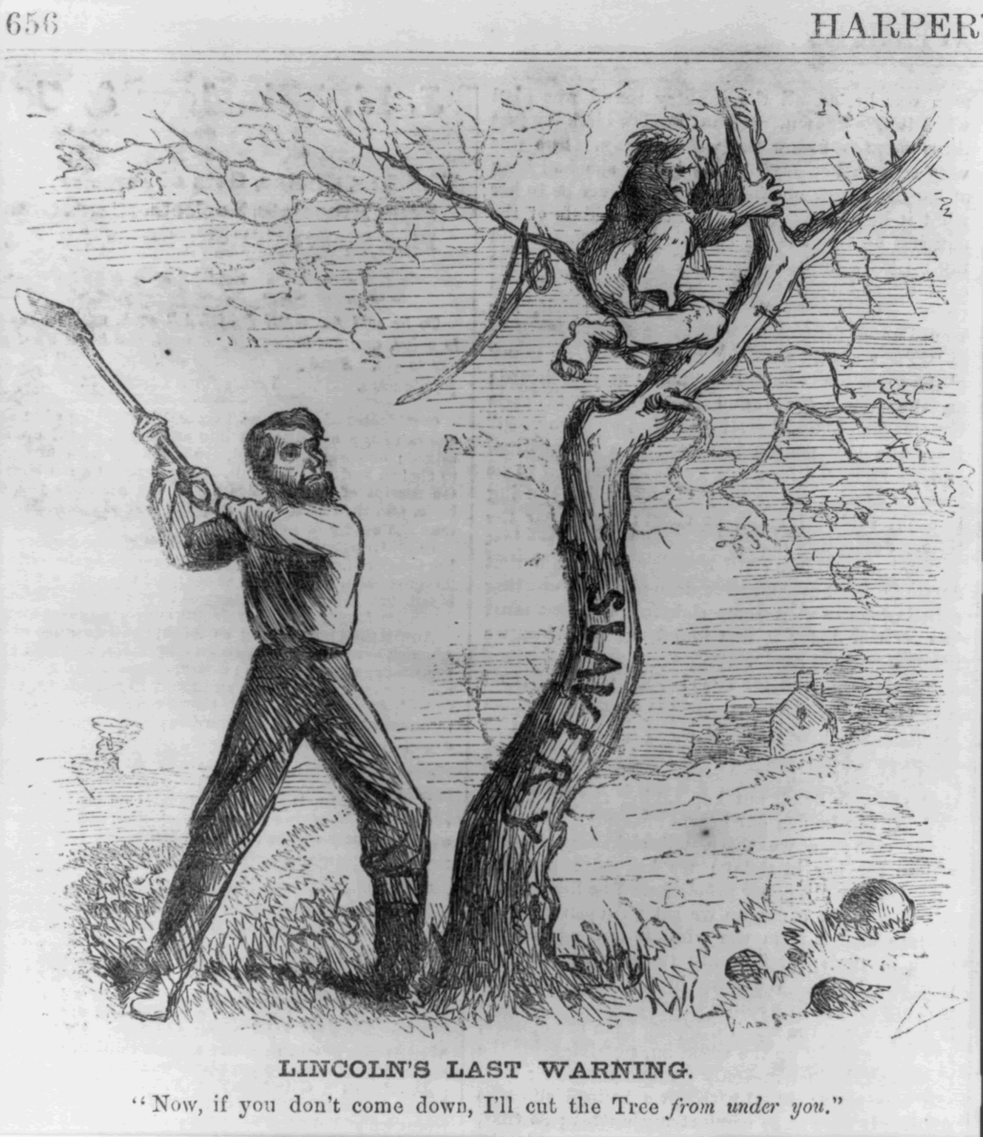

Slide 15
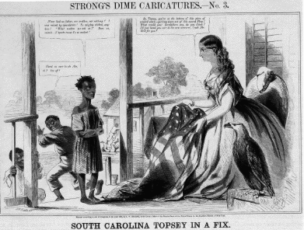

Slide 16
